Slide 1
Using STATA® for Meta-analysis
Peter Francis Raguindin
Institute of Social and Preventive Medicine, Bern, Switzerland
Swiss Paraplegic Research, Nottwil, Switzerland
peter.raguindin@ispm.unibe.ch

Slide 2

Lessons learned
Extremely challenging
Process oriented
Organization is key
Helps develop your future research ideas
Meeting notes
Tabbed articles for data extraction
STATA outputs
Toblerone regular bar to scale
Manuscript drafts and revisions

Slide 3
Meta-analysis
A statistical analysis which combines the results of several independent studies considered by the analyst to be “combinable”
You will learn how to run meta-analysis on STATA (basic)
To structure your dataset
To install meta-analysis packages
To import and describe dataset
To compute for pooled estimates
You will interpret the results and apply basic concepts of fixed-effect and random effect

Slide 4
STATA ®

Slide 5
STATA ®

Slide 6
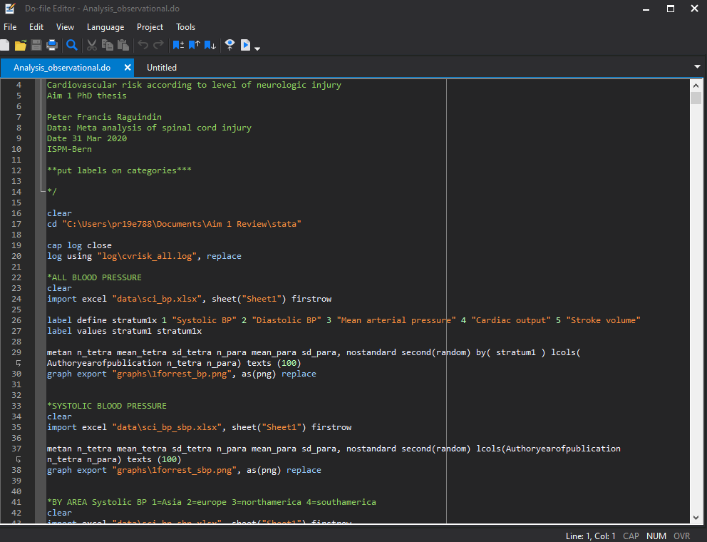
STATA ®

Slide 7


Fixed effects vs Random effects
$$W=\frac{1}{V_{i}}$$
$$W=\frac{1}{V_{i}+ τ}$$
Fixed effect
Random effects
Notes:
In both fixed and random models the weight is the inverse of the variance. However, the variance in the random effect is within-study variance for study (i) plus the between-studies variance, tau-squared; how much of the true effects varies from study to study

Slide 8
Installing the package
ssc install metan
Meta-analysis package
ssc install metabias
Funnel plot and egger’s test
ssc install metaninf
Leave one out analysis
ssc install metareg
Meta regression
Remember, there are two main effect estimate that we can pool using metan command
A binary data (2x2 table)
A continuous data
IMPORTANT
help (opens up the help file)
describe (describes your dataset)
codebook (provides detailed information on your dataset)
import open (imports or opens your dataset of another format)

Slide 9

Sample Study

Slide 10
Exercise 1: Blood pressure study
Is there difference in the blood pressure of individuals with spinal cord injury according to the different levels of injury?
Meta-analysis of observational studies
Population: Individuals with Spinal cord injury
Exposure: Spinal cord injury levels (tetraplegia and paraplegia)
Outcome: Blood pressure
Data type: CONTINUOUS
Data: sci_bp_sbp.xlsx
metan <varlist>, [options]
Options
fixed random
standard nostandard
second(model or estimates and description) first(estimates and description)
rfdist

Slide 11
Guide Questions
Do preliminary dataset check
Is there any difference between the blood pressure of tetraplegia and paraplegia?
Compute for mean difference using fixed effect and random effects model
Compute for standardized mean difference fixed effect and random effects model
Export your forest plot
Who has higher systolic blood pressure?
Bonus question: What are the mean difference according to the location of the study
Do a subgroup analysis according to the area

Slide 12
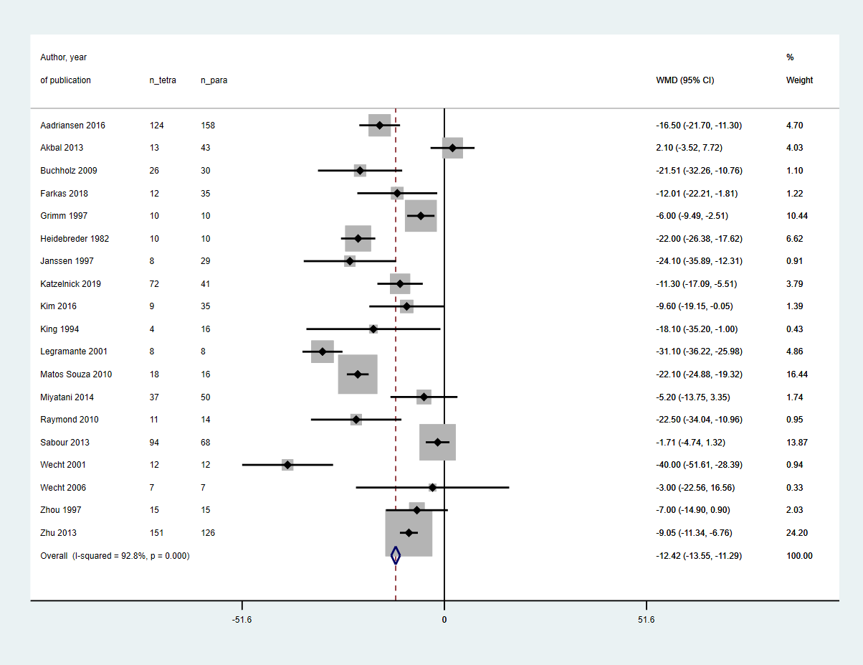
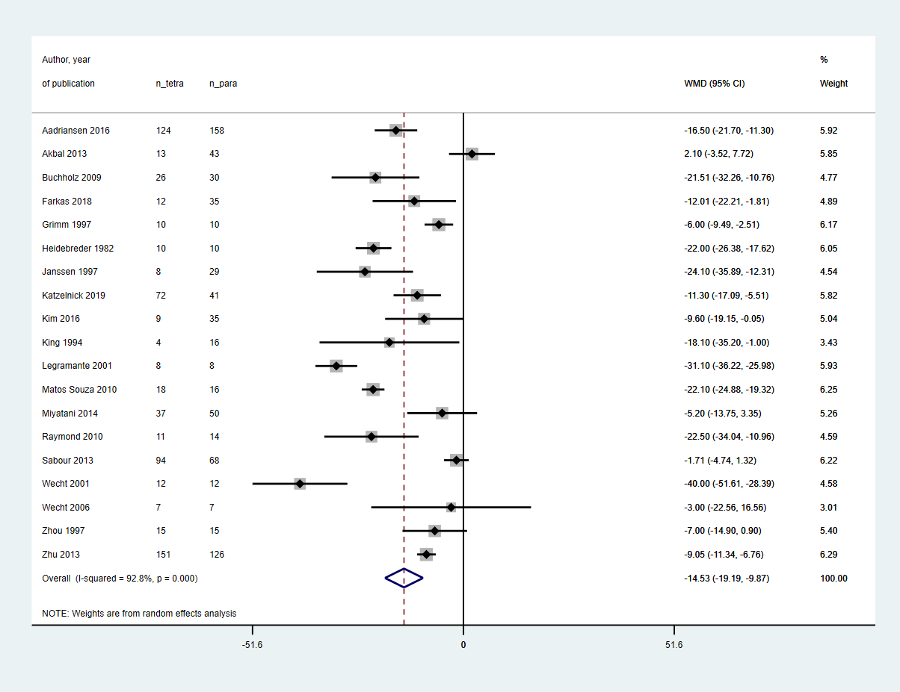
Solution
Fixed-effects (WMD)
Random effects (WMD)

Slide 13
Exercise 2: Streptokinase study
What is the effect of intravenous streptokinase on early mortality in patients with acute myocardial infarction?
Meta-analysis of randomized controlled trials
Population: Adults diagnosed with acute myocardial infarction
Intervention: intravenous streptokinase
Control: no streptokinase
Outcome: mortality
Data type: BINARY or DICHOTOMOUS
Data: strepto.dta
generate <newvar>= <argument>
metan <varlist>, [options]
Options
rr or rd
fixed fixedi random
standard nostandard
second(model or estimates and description) first(estimates and description)
rfdist

Slide 14
Questions
Do preliminary dataset check
Using risk ratio, what is the risk difference between streptokinase and control?
WARNING! The command requires to put individuals with and without the outcome.
Compute for the risk ratio for each study and pooled effect
Compute using fixed effect model using Inverse variance
Random effects model using Inverse variance
Is streptokinase beneficial?
Bonus questions
Do a subgroup analysis based on the year criteria on acute myocardial infarction was changed (stratum1) *hypothetical

Slide 15
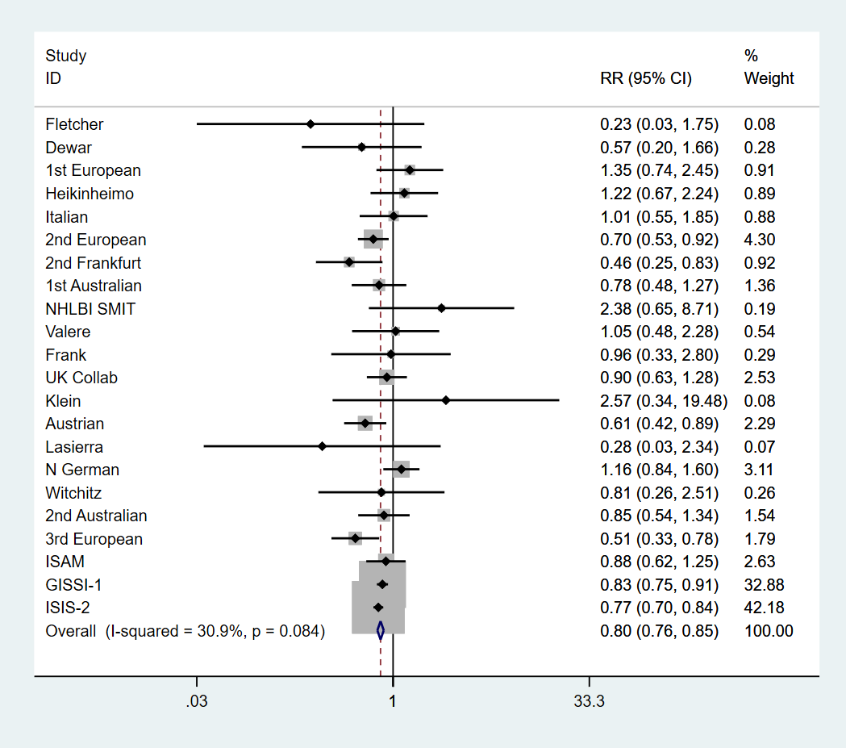
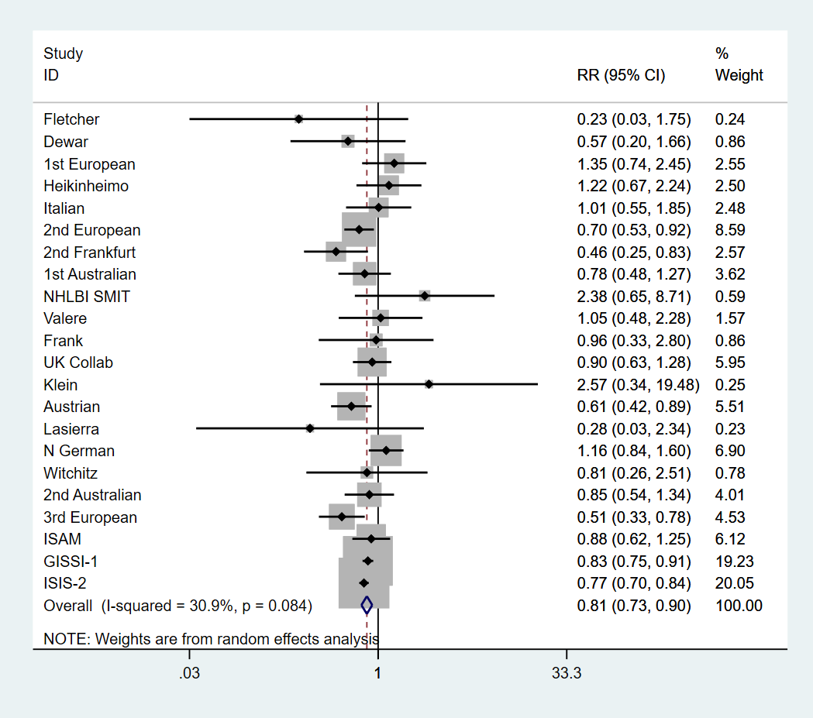
Solution
Fixed-effect (RR)
Random-effects (RR)

